Slide 1

Customer Segmentation Using K-Means

Slide 2

Addressing Customer Diversity
Businesses often struggle to gain a nuanced understanding of their diverse customer base. Our objective is to apply K-Means clustering, a powerful unsupervised learning algorithm, to segment customers into distinct groups based on key behavioral metrics.
We focus on three primary features for segmentation: customer age, annual income, and a proprietary spending score derived from transactional data. This segmentation will enable targeted marketing strategies.

Slide 3
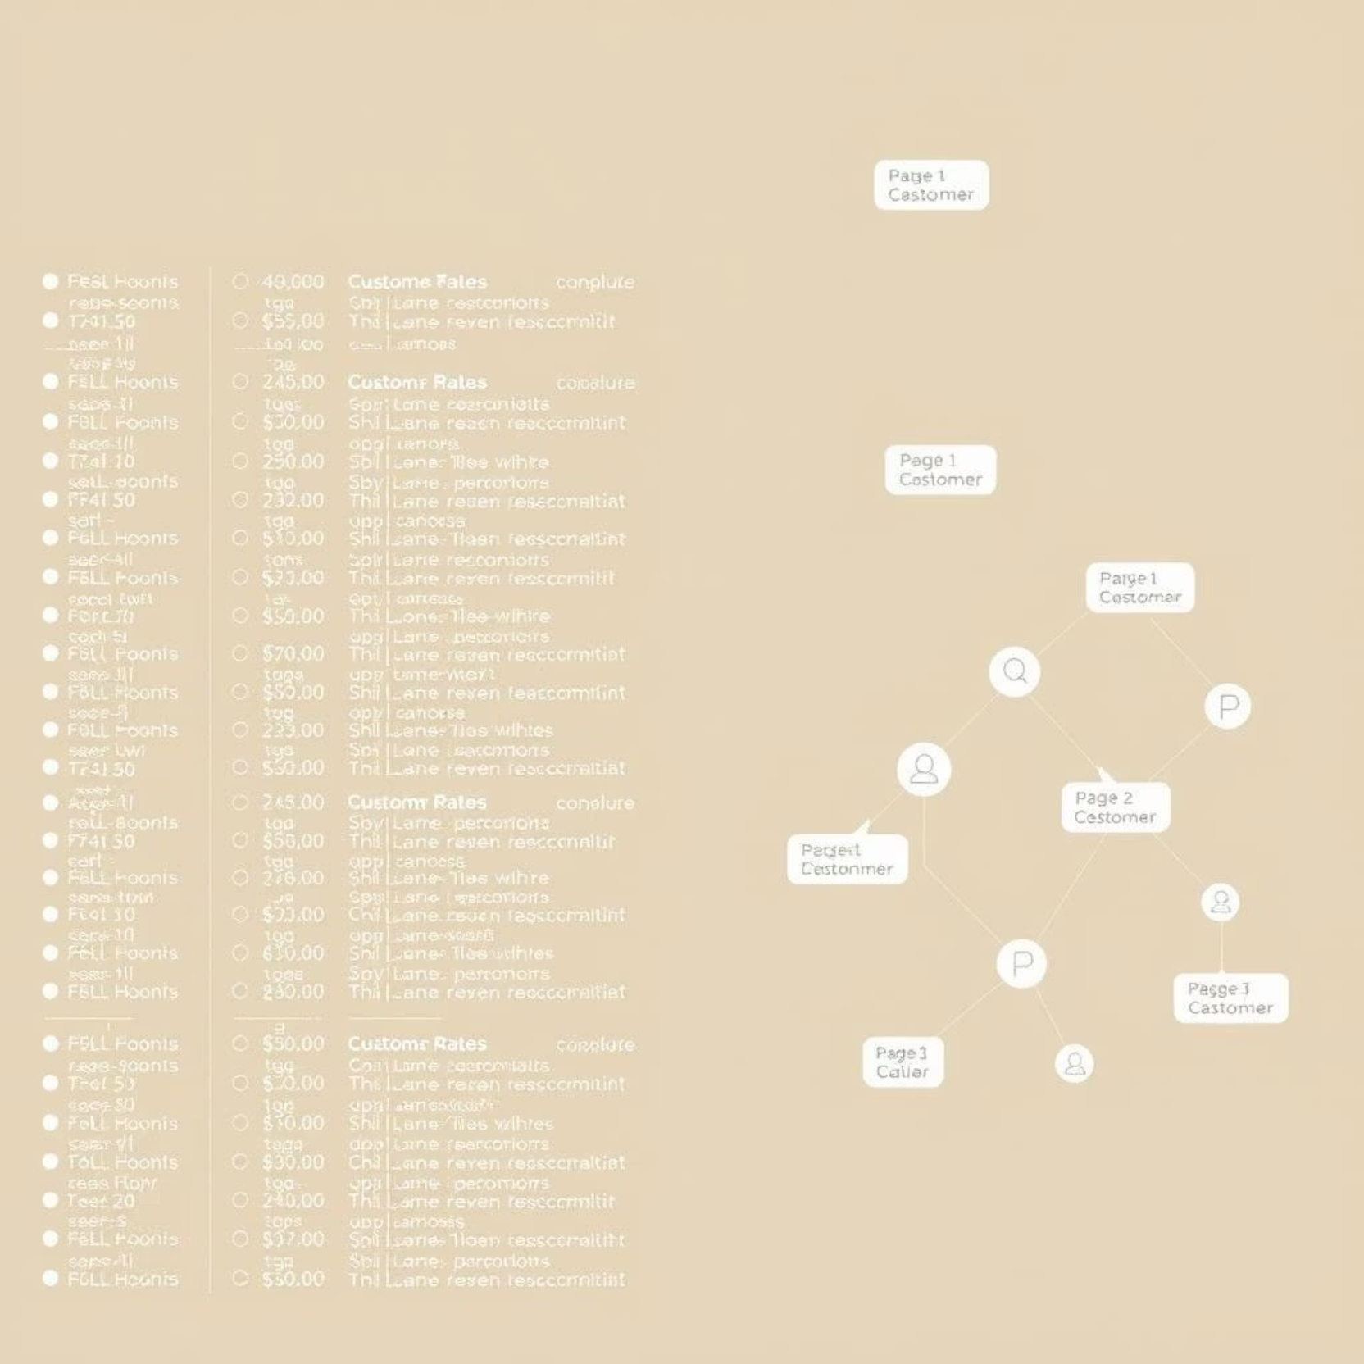
Dataset Overview: Mall_Customers.csv
Our analysis is based on the Mall_Customers.csv dataset, comprising data for 200 unique customers. Each record in the dataset provides critical information for our segmentation efforts.
Number of Records: 200 customers, providing a substantial sample size for robust clustering.
Key Features: The dataset includes 'Age', 'Annual Income (k$)', 'Spending Score (1-100)', and 'Gender'. These attributes capture crucial demographic and behavioral patterns for each customer.

Slide 4

Exploratory Data Analysis (EDA)
Distribution Analysis: We examined the distribution of 'Age', 'Annual Income', and 'Spending Score' to understand their spread and identify any skewness or outliers. Histograms and density plots were instrumental in this phase.
Correlation Checks: A correlation matrix was computed to assess the relationships between numerical features, identifying dependencies that could influence clustering.
Boxplot Visualization: Boxplots were generated for each numerical feature to visualize their quartiles and detect the presence of outliers.
Gender Analysis: Gender distribution was analyzed, and its impact on spending habits was explored to provide additional context for segmentation.

Slide 5





Data Preprocessing: Preparing for K-Means
Whitespace Removal
Column names were cleaned by removing leading/trailing whitespaces to ensure consistency and prevent indexing errors during processing.
Feature Normalization
Using StandardScaler, 'Age', 'Annual Income', and 'Spending Score' were scaled to a mean of 0 and variance of 1, preventing features with larger ranges from dominating the clustering process.
Feature Selection
For clustering, we specifically chose 'Age', 'Annual Income', and 'Spending Score', as these attributes are most indicative of customer behavior and segmentation potential. Gender was excluded to prevent bias.

Slide 6
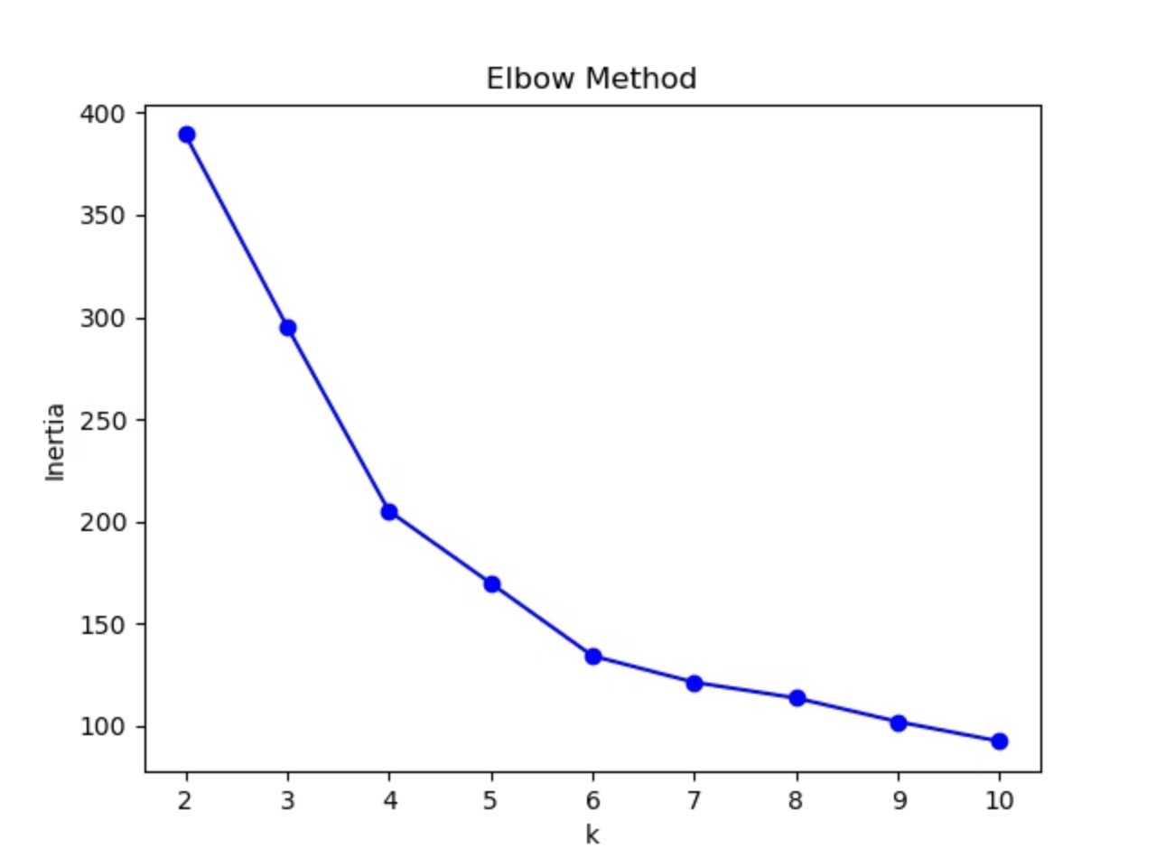
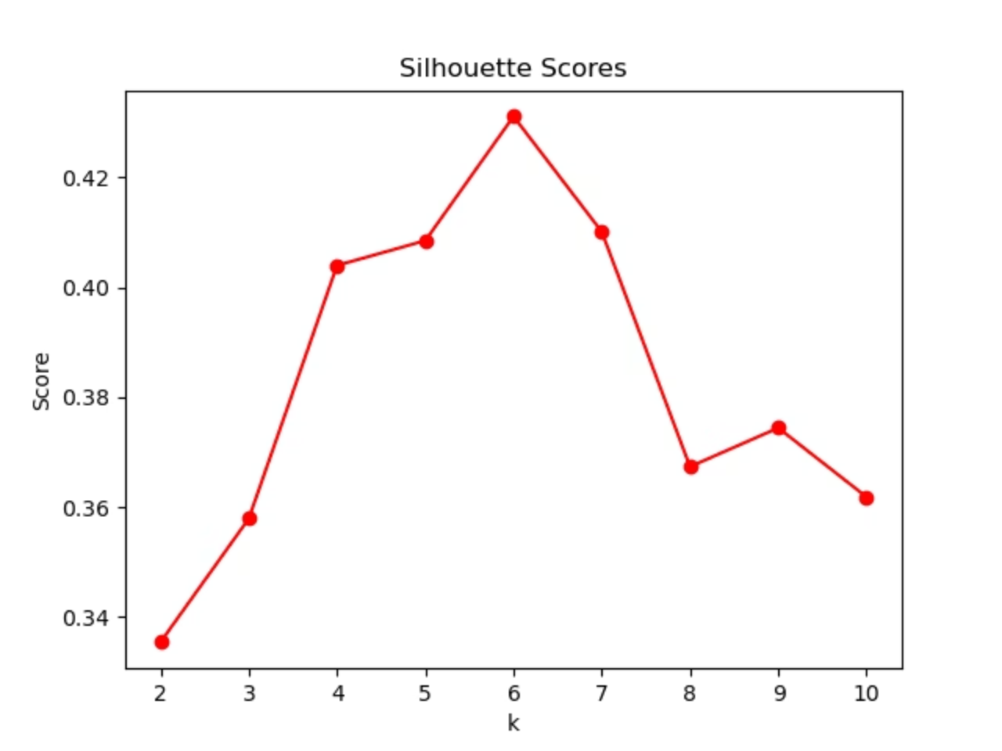
Determining Optimal Clusters (K)
To identify the optimal number of clusters (k), two primary methods were employed:
Elbow Method: By plotting the Within-Cluster Sum of Squares (WCSS) against the number of clusters, an "elbow" point was identified at k=5, indicating the point of diminishing returns for additional clusters.
Silhouette Score: This metric quantifies how similar an object is to its own cluster compared to other clusters. A higher silhouette score confirms k=5 as an optimal choice, signifying well-defined and separated clusters.

Slide 7

K-Means Implementation
K-Means Application
The K-Means algorithm was applied to the preprocessed data with the identified optimal number of clusters, k=5. The algorithm iteratively assigned data points to clusters and updated cluster centroids.
Labeled Dataset Creation
After the clustering converged, each customer in the dataset was assigned a cluster label, indicating their respective segment. This labeled dataset forms the basis for subsequent analysis.
Integration with Dataframe
The newly generated cluster labels were appended as a new column to the original dataframe, allowing for direct comparison and analysis of customer features within their assigned segments.

Slide 8
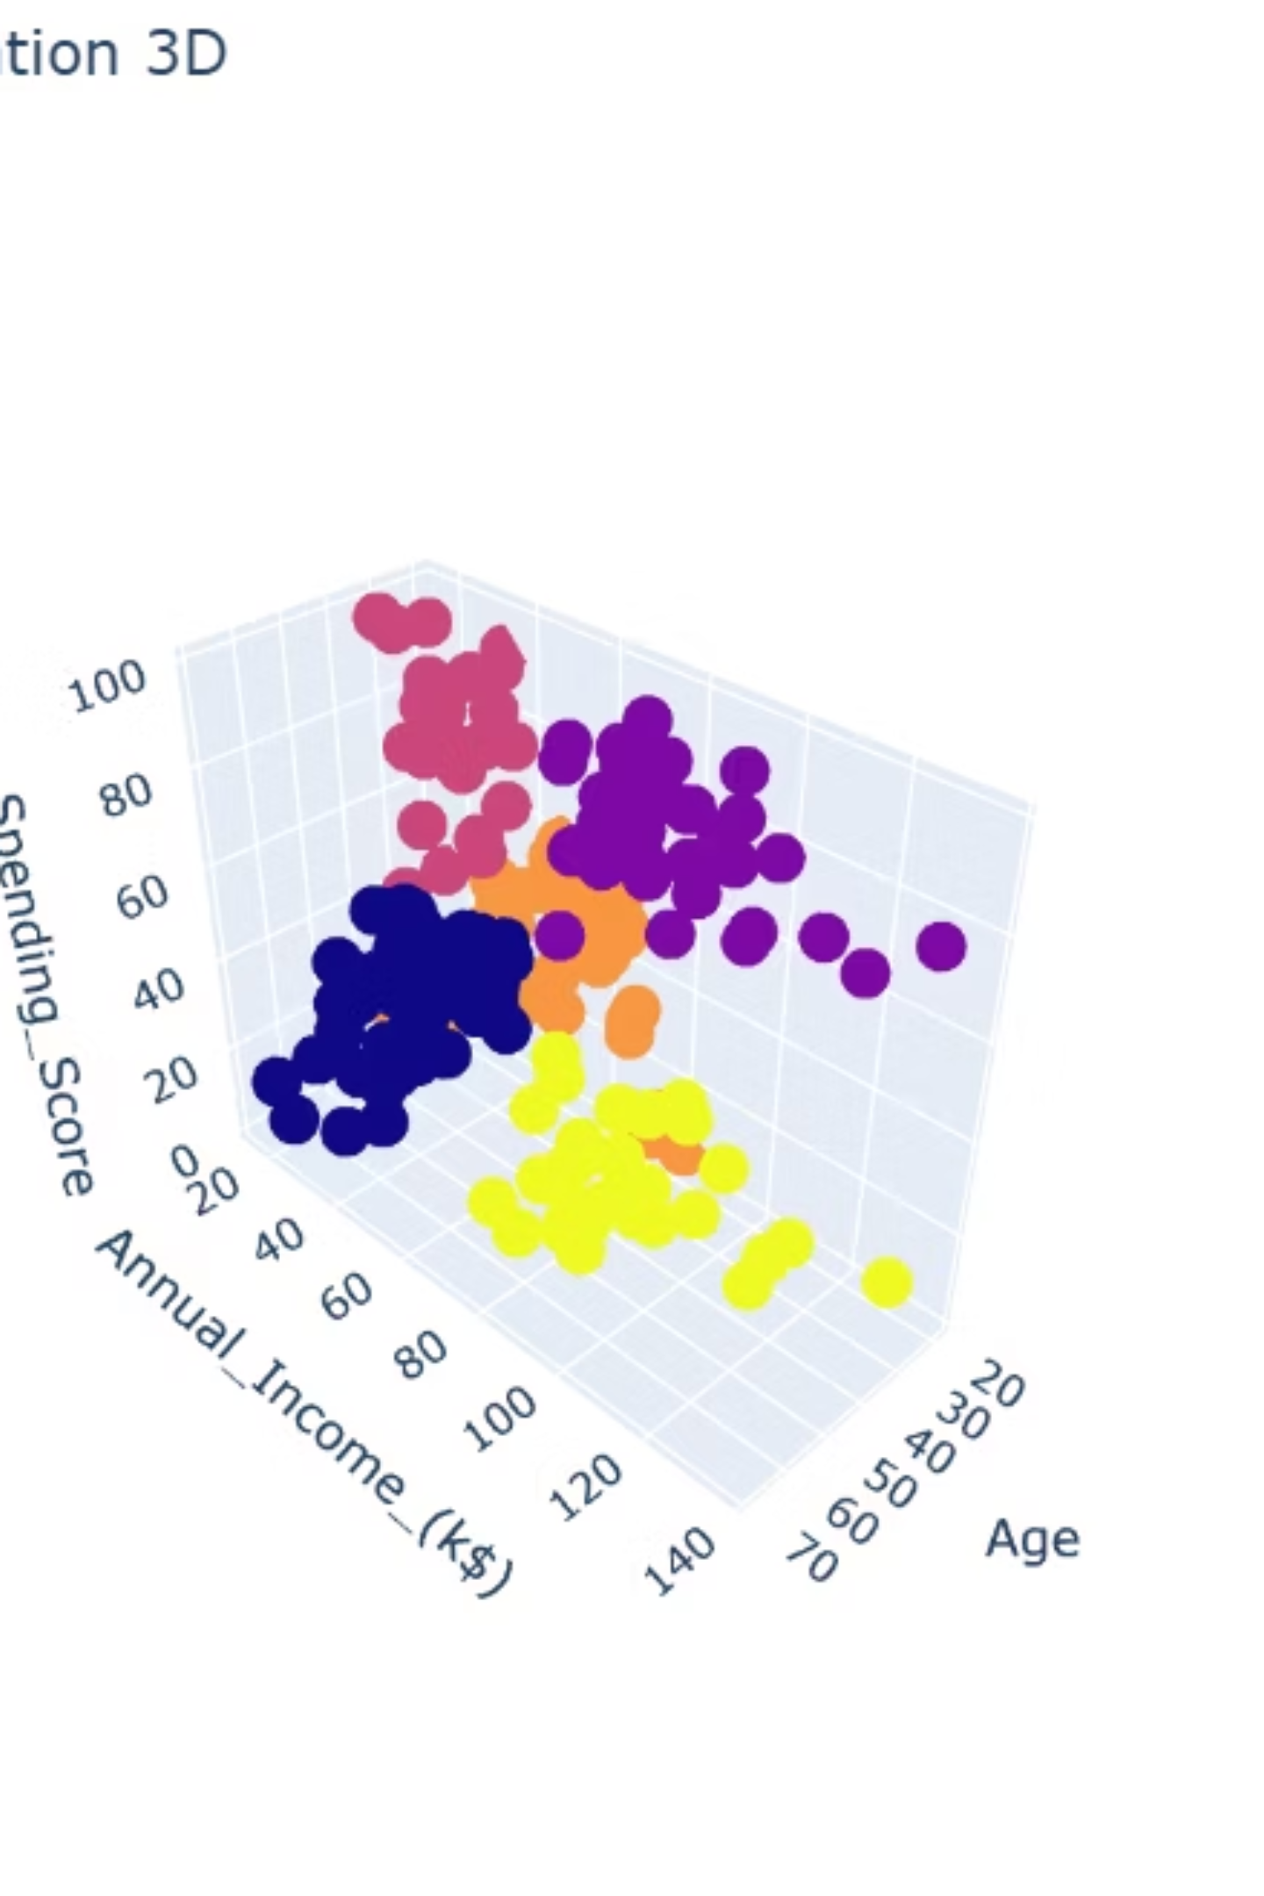
3D Cluster Visualization
To visually inspect the effectiveness of the K-Means clustering, a 3D scatter plot was generated using Plotly. This interactive visualization allows us to observe the distinct separation of customer segments across the dimensions of Age, Annual Income, and Spending Score. Each color represents a unique cluster, demonstrating how customers are grouped based on their similarity in these key features. The interactive HTML file, 3d_cluster_plot.html, is available in the /images/ directory for a more immersive exploration.

Slide 9
Detailed Cluster Profiles
0
55.3
47.6
41.7
33 / 25
Older customers with moderate income and spending habits. Ideal for loyalty programs.
1
32.9
86.1
81.5
22 / 18
Younger, high-income, and high-spending customers. Prime candidates for premium products.
2
25.8
26.1
74.8
15 / 11
Youthful individuals with lower income but frequent spending. Highly responsive to discounts.
3
26.7
54.3
40.9
27 / 18
Young mid-income customers with balanced spending. Strong cross-selling potential.
4
44.4
89.8
18.5
15 / 16
Wealthy but frugal customers. Require specific campaigns to trigger interest and engagement.

Slide 10
Targeted Marketing Strategies
0
Loyal, older spenders
Implement exclusive loyalty programs and offer personalized referral coupons to maintain engagement.
1
High spend, high income
Focus on upsell opportunities for luxury goods, premium memberships, and exclusive concierge services.
2
Budget-conscious youth
Leverage flash sales, collaborate with social media influencers, and integrate gamification to drive purchases.
3
Balanced income and spend
Develop cross-selling campaigns for complementary products and seasonal promotions tailored to their interests.
4
Wealthy but disengaged
Initiate highly personalized engagement campaigns and compelling brand storytelling to pique their interest and encourage spending.

